Slide 1
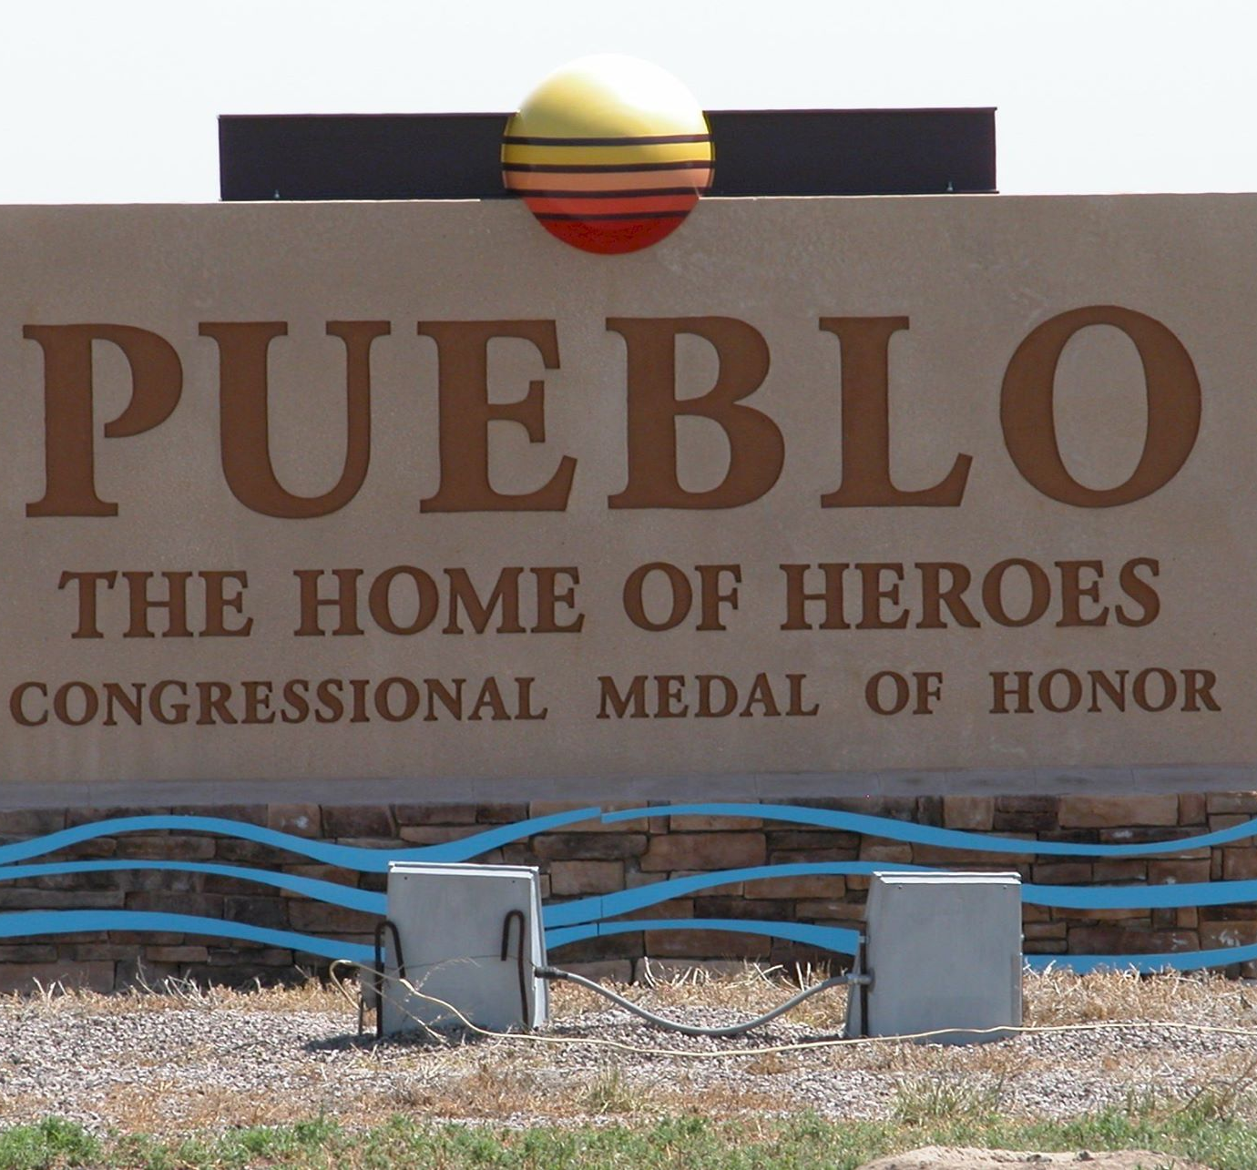
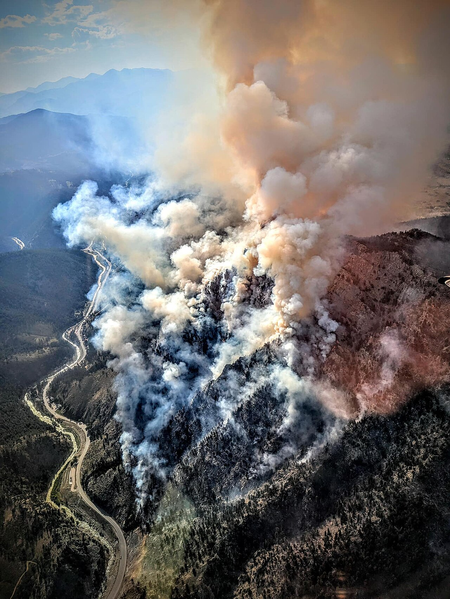
Source: Wikimedia Commons
Source: Wikimedia Commons

Slide 2
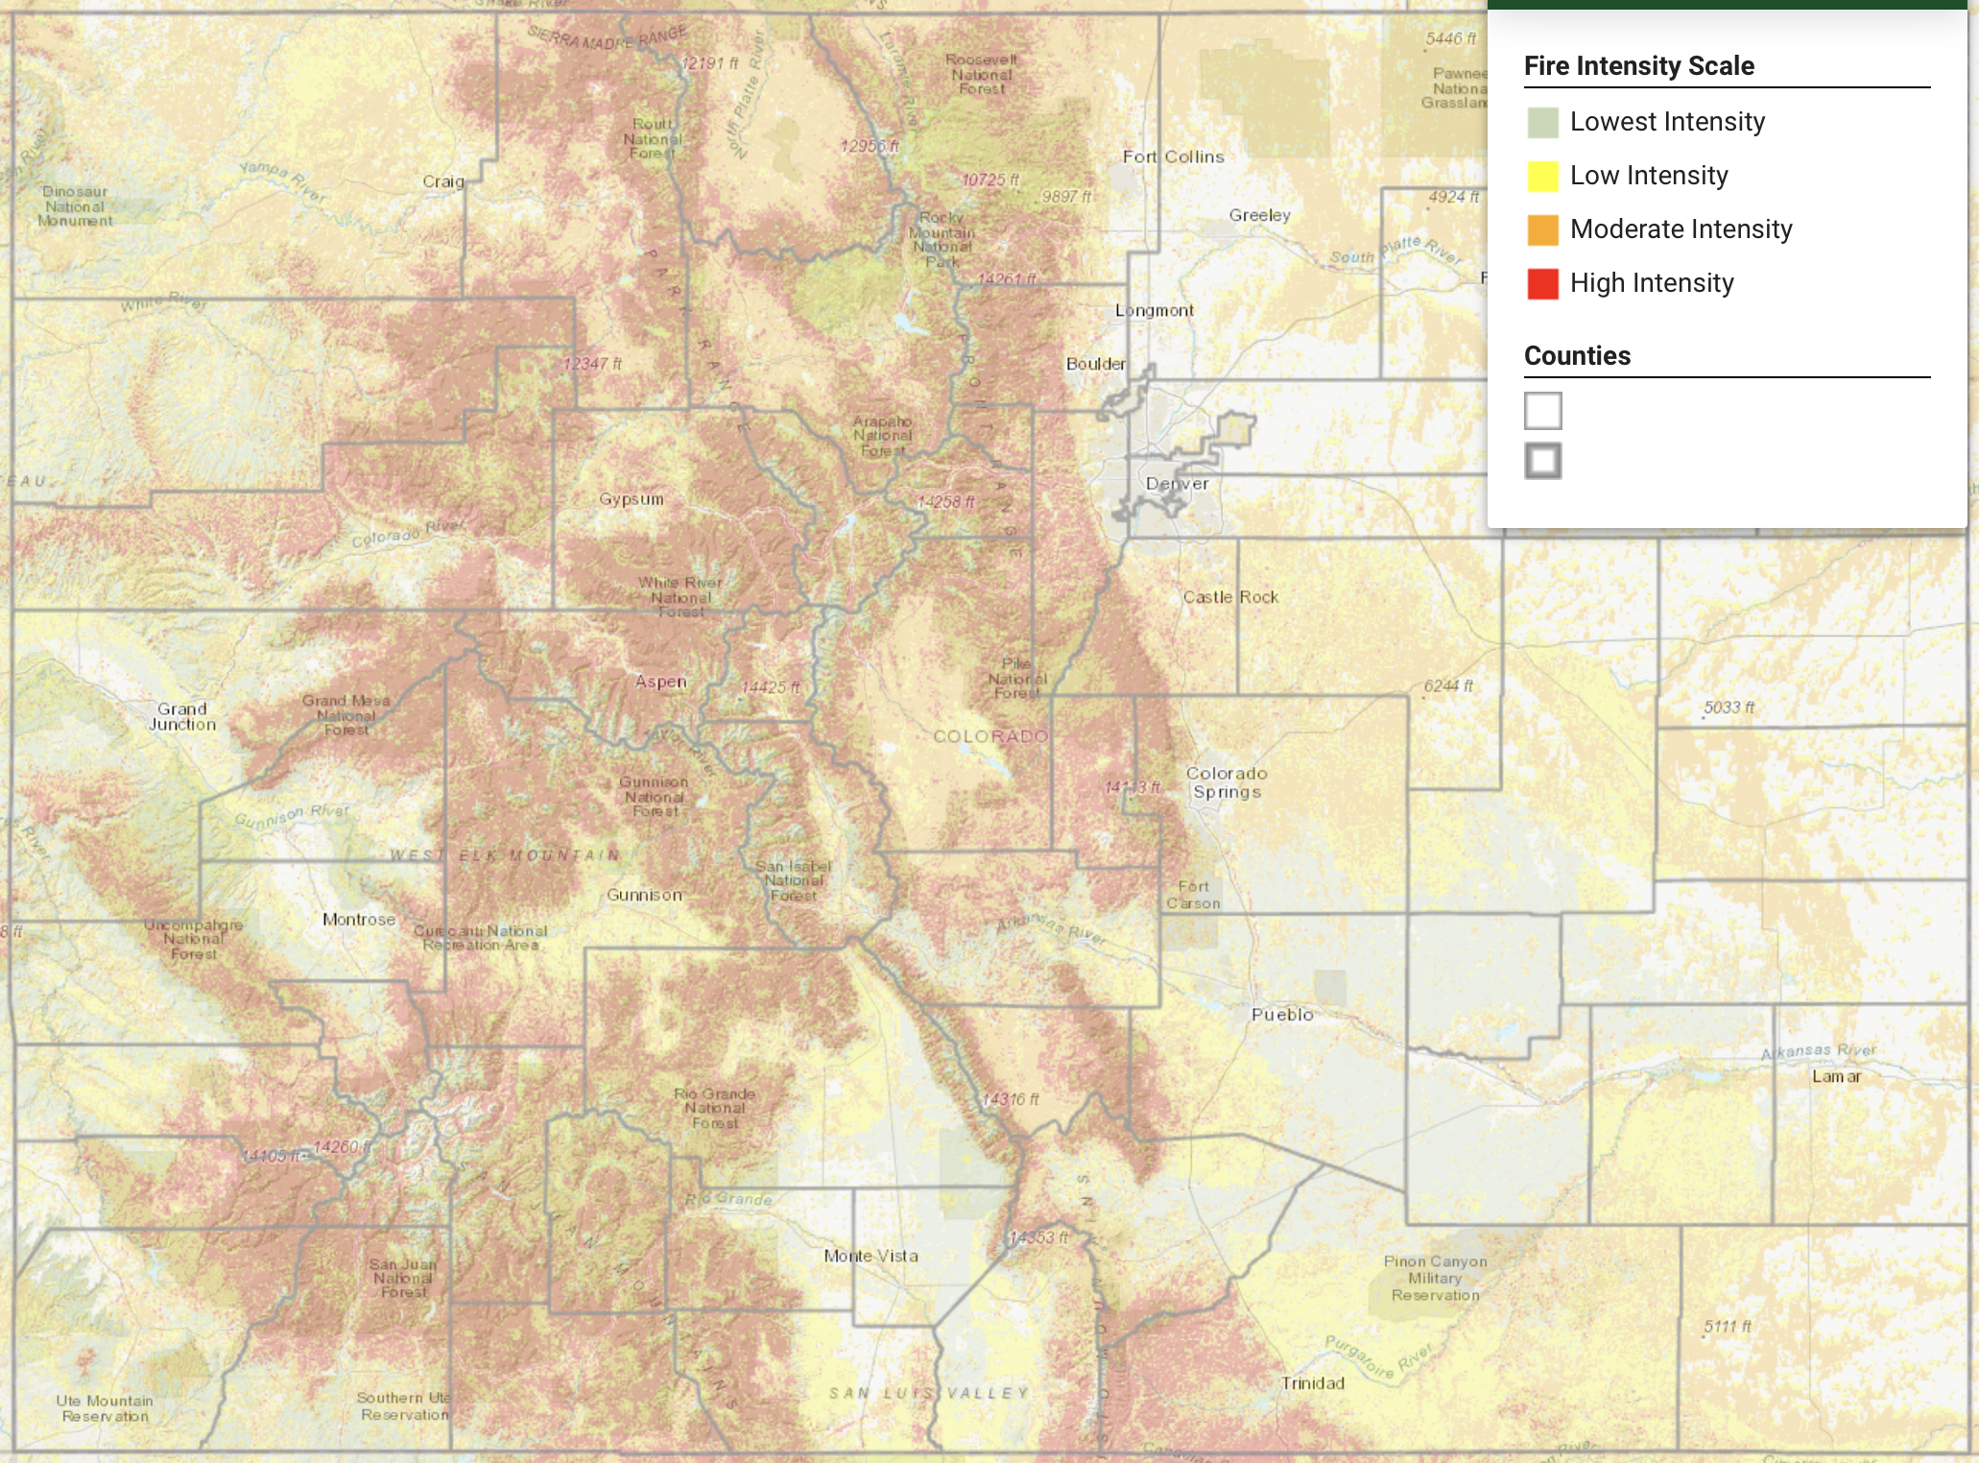
Pueblo, CO
Moderate risk on average, but close enough to hotspots for occasional spikes
~100mi to Denver, ~50mi to Colo. Spgs
Source: Colorado Wildfire Risk Public Viewer

Slide 3
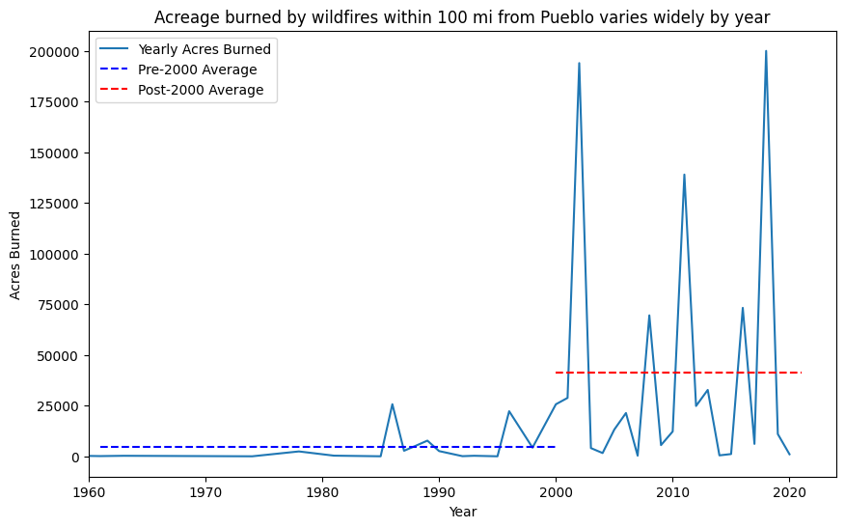

Slide 4
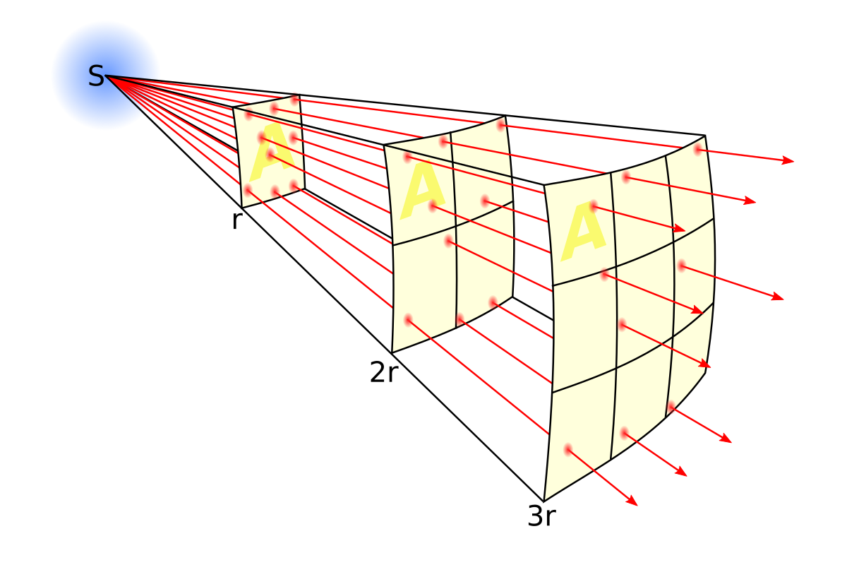
Source: Wikimedia Commons

Slide 5
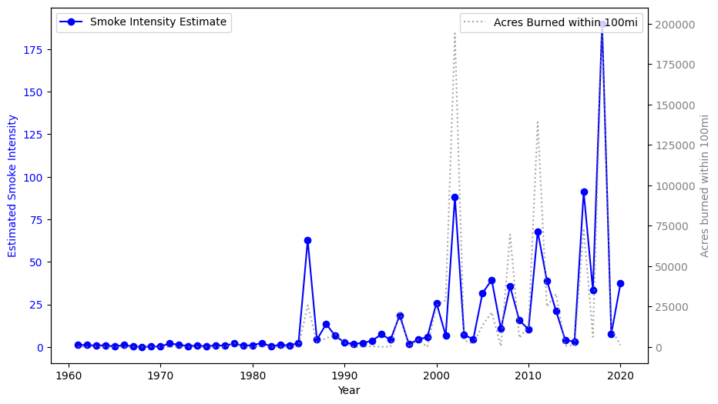
Smoke intensity estimate is less volatile than acres burned within 100mi

Slide 6

Source: Wikimedia Commons

Slide 7
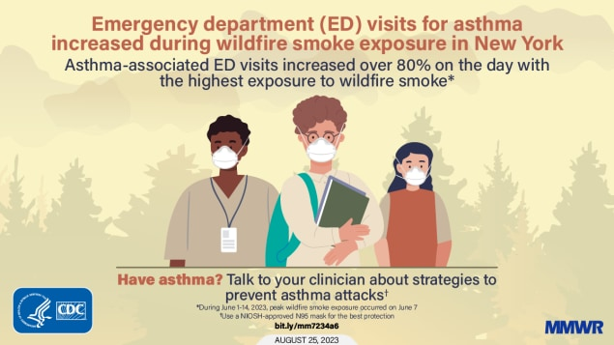
Source: Centers for Disease Control

Slide 8
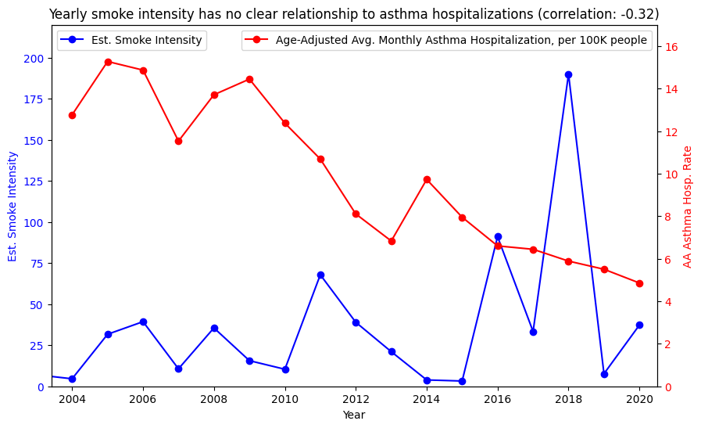

Slide 9
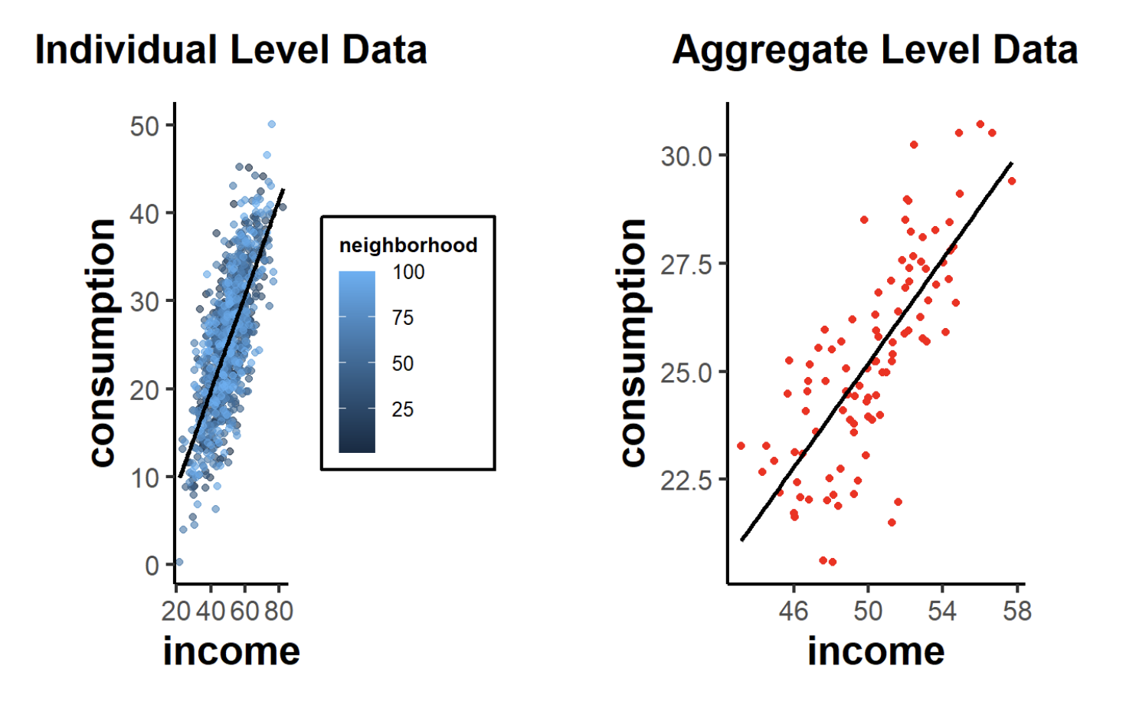
Source: Nguyen, M. (2020). A Guide on Data Analysis. Bookdown. https://bookdown.org/mike/data_analysis/

Slide 10
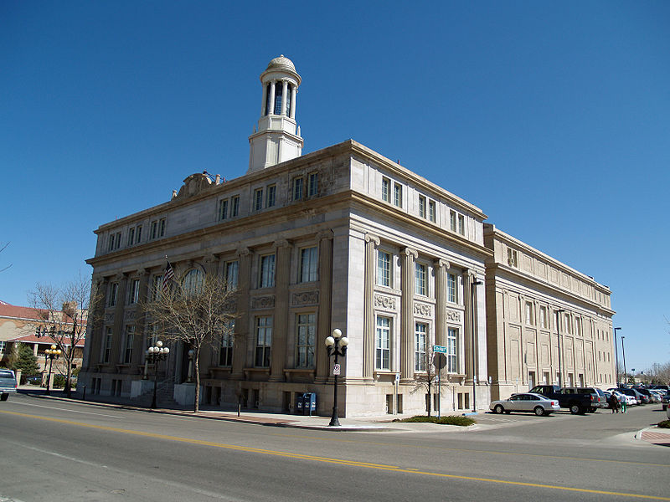
Source: Wikimedia Commons

